Slide 1
Socket

Slide 2
Simple Socket Programming

Slide 3
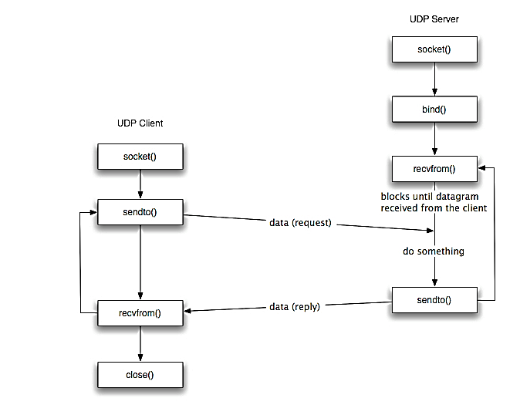

Slide 4
File Operation

Slide 5
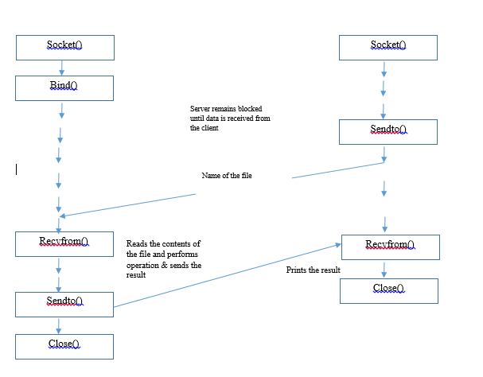
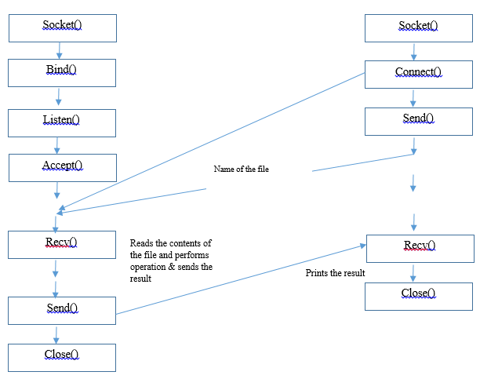
Server
Client
Server
UDP
Client
TCP

Slide 6
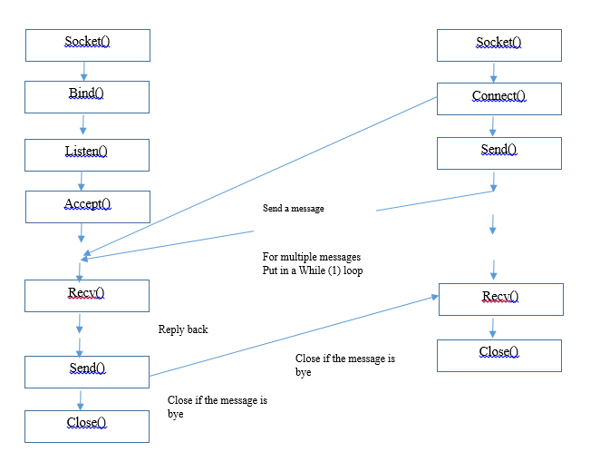
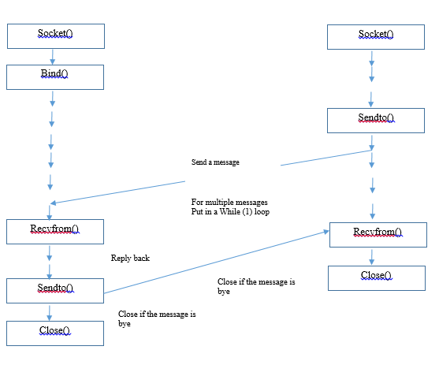
Server
Client
Server
UDP
Client
TCP

Slide 7
Half Duplex Chat

Slide 8
Full Duplex Chat

Slide 9
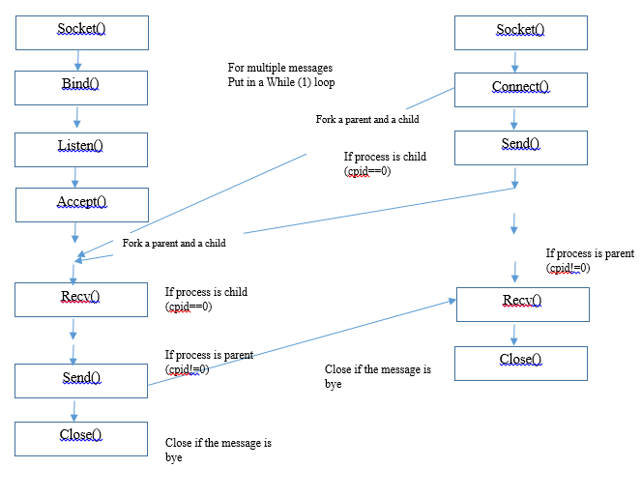
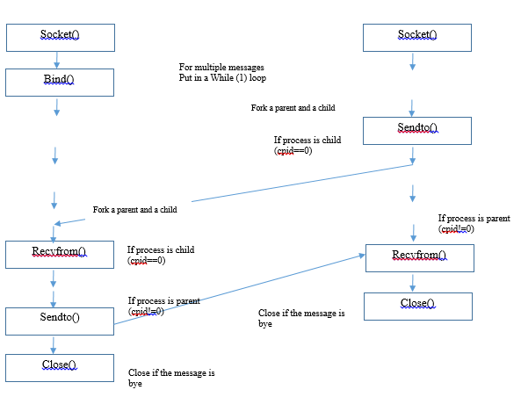
Server
Client
Server
UDP
Client
TCP

Slide 10
Single Server Multiple Client

Slide 11
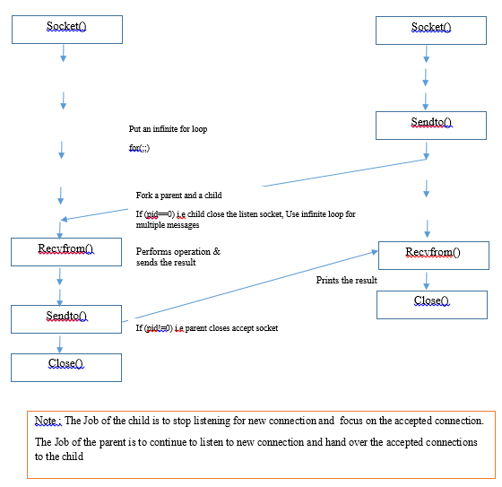
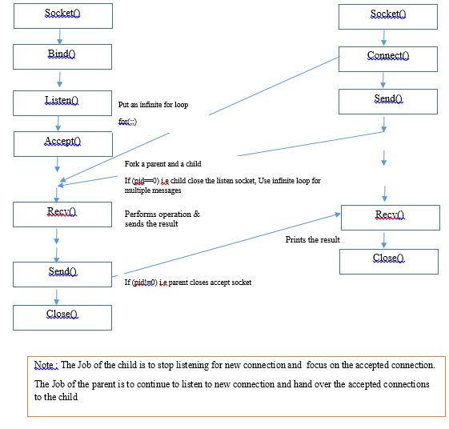
Server
Client
Server
UDP
Client
TCP

Slide 12
File operations

Slide 13
To close a function you can use the function:
int fclose(FILE *a_file);
fclose returns zero if the file is closed successfully.
An example of fclose is:
fclose(fp);
For C File I/O you need to use a FILE pointer, which will let the program keep track of the file being accessed. For Example:
FILE *fp;
To open a file you need to use the fopen function, which returns a FILE pointer. Once you've opened a file, you can use the FILE pointer to let the compiler perform input and output functions on the file.
FILE *fopen(const char *filename, const char *mode);
Here filename is string literal which you will use to name your file and mode can have one of the following values
w - open for writing (file need not exist)
a - open for appending (file need not exist)
r - open for reading
Write to a file :
fprintf(fptr,"%d",num);
Read from a file :fscanf(fptr,"%d", &num);

Slide 14
Fork()
Subtitle

Slide 15
The system call getpid() returns the process ID of the calling process.
#include <sys/types.h>
#include <unistd.h>
pid_t getpid(void);
This call returns the process ID of the calling process which is guaranteed to be unique. This call is always successful and thus no return value to indicate an error.
The fork() does not take any parameter, it returns integer values. It may return three types of integer values.
Negative Number: It returns negative number when child process creation is failed
Zero Value: It returns Zero for the newly created child process
Positive Value: The positive value is returned to the parent process.
Example Code
#include <stdio.h>
#include <sys/types.h>
#include <unistd.h>
int main() {
fork(); //make a child process of same type
printf("Fork testing code\n");
return 0;
}
The system call getppid() returns the Parent PID of the calling process.
#include <sys/types.h>
#include <unistd.h>
pid_t getppid(void);
This call returns the parent process ID of the calling process. This call is always successful and thus no return value to indicate an error.

Slide 16
#include <stdio.h>
#include <stdlib.h>
#include <sys/types.h>
#include <unistd.h>
int main() {
int mypid, myppid;
printf("Program to know PID and PPID's information\n");
mypid = getpid();
myppid = getppid();
printf("My process ID is %d\n", mypid);
printf("My parent process ID is %d\n", myppid);
printf("Cross verification of pid's by executing process commands on shell\n");
system("ps -ef");
return 0;
}

Slide 17
Thank YOU!!! ☺

